Slide 1




ID/X Partners
Data Engineer Virtual Internship Program – June 2023
Developing a Data Warehouse
for the Needs of Client in ID/X Partners
By Adrian Maulana Muhammad
https://github.com/adrn-mm/FinalTask_IDX-Partners_DE_Adrian-Maulana-Muhammad
https://www.youtube.com/watch?v=Tbi_46TBJHg

Slide 2


Personal Background
Case Study Overview
Project Workflow
Importing Staging Database
Creating the Data Warehouse & Tables
Extract, Transform, & Load Process
Data Modeling
Developing the Stored Procedures
Dashboard Data Visualization
Project Resource & Documentation

Slide 3

Personal Background

Slide 4

About Me
Name: Adrian Maulana Muhammad
D.O.B: 18 July 1996
Profession: Data Engineer
E-mail: adrian.m.muhammad@gmail.com
Linkedin: linkedin.com/in/adrn-mm
Portfolio: adrian-maulana.com
“A mathematics graduate and a Data Engineer who responsible for designing, building, and maintaining the data architecture needed to transform raw data into meaningful insights.”

Slide 5
Case Study Overview

Slide 6
Client Requests
One of the clients of ID/X Partners, operating in the e-commerce industry, has a requirement to create a Data Warehouse from multiple tables in the source database. This Data Warehouse will consist of one Fact table and several Dimension tables. As a Data Engineer, there are several tasks that need to be performed:
Importing/Restoring the Staging Database.
Creating a Database named DWH_Project and generating Fact and Dimension Tables from the tables in the Staging Database.
Building an ETL Job in Talend application to transfer data from the Staging to the Data Warehouse. Specifically for the DimCustomer Table, perform data transformation by converting the data in the FirstName and LastName columns to uppercase and then combining both columns into a single column named CustomerName.
Creating a Stored Procedure (SP) to display a summary of sales orders based on their delivery status.

Slide 7
Project Workflow

Slide 8
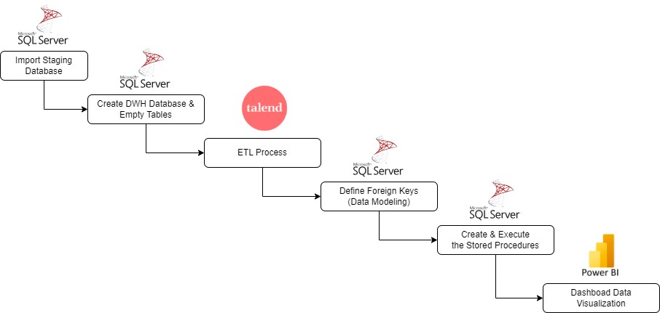
Project Workflow

Slide 9
Importing Staging Database

Slide 10
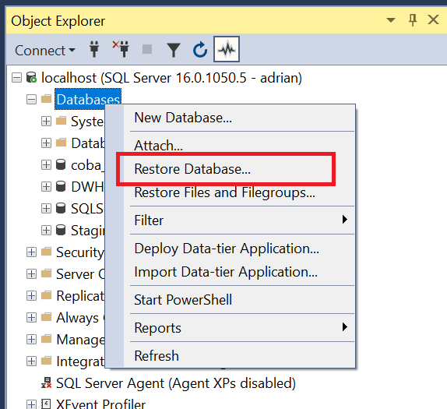
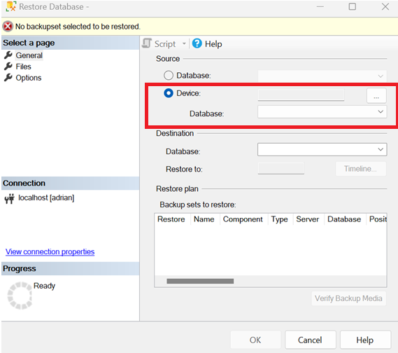
Restore Staging Database
1. Right-click on the database and select "Restore Database".
2. Then select "Device" and browse for the intended Staging.bak file.

Slide 11
Creating the Data Warehouse & Tables

Slide 12
Queries for Creating Database & Tables
Create the Dim & Fact Tables
USE DWH_Project;
CREATE TABLE DimCustomer (
CustomerID INT NOT NULL PRIMARY KEY,
FirstName VARCHAR(50) NOT NULL,
LastName VARCHAR(50) NOT NULL,
CustomerName VARCHAR(255) NOT NULL,
Age INT NOT NULL,
Gender VARCHAR(50) NOT NULL,
City VARCHAR(50) NOT NULL,
NoHp VARCHAR(50) NOT NULL
);
CREATE TABLE DimStatusOrder (
StatusID INT NOT NULL PRIMARY KEY,
StatusOrder VARCHAR(50) NOT NULL,
StatusOrderDesc VARCHAR(50) NOT NULL
);
CREATE TABLE DimProduct (
ProductID INT NOT NULL PRIMARY KEY,
ProductName VARCHAR(255) NOT NULL,
ProductCategory VARCHAR(255) NOT NULL,
ProductUnitPrice INT NULL
);
CREATE TABLE FactSalesOrder (
OrderID INT NOT NULL PRIMARY KEY,
CustomerID INT NOT NULL,
ProductID INT NOT NULL,
Quantity INT NOT NULL,
Amount INT NOT NULL,
StatusID INT NOT NULL,
OrderDate DATE NOT NULL,
);
Create the DWH Database
CREATE DATABASE DWH_Project;

Slide 13
Extract, Transform, & Load Process

Slide 14
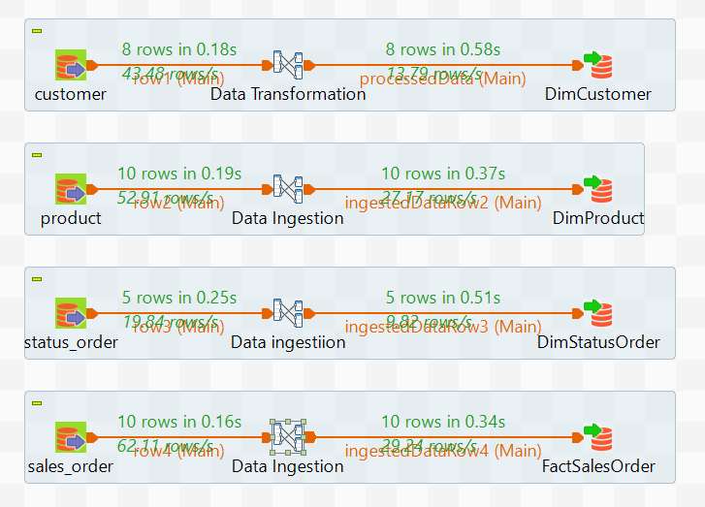
Talend Job

Slide 15
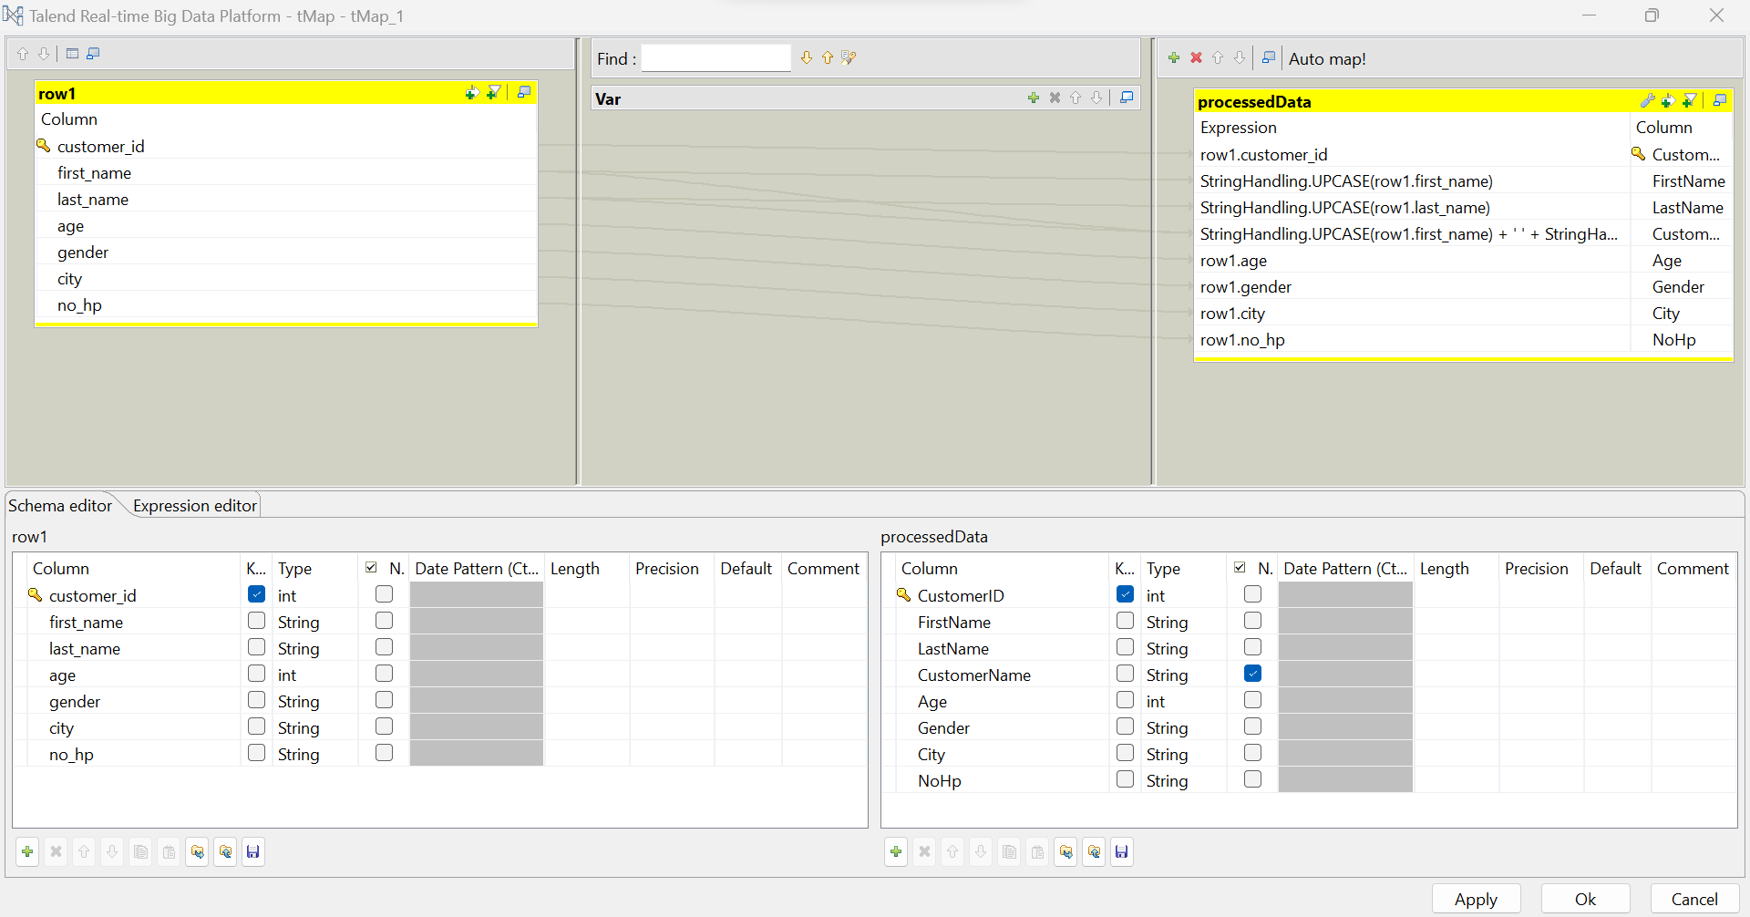
tMap Data Transformation Details

Slide 16
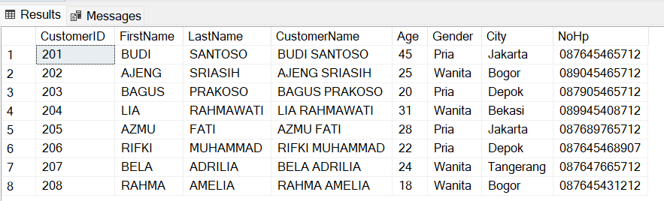
Data Transformation Output

Slide 17
Data Modeling

Slide 18
Queries for Defining the Foreign Keys
USE DWH_Project;
ALTER TABLE FactSalesOrder
ADD FOREIGN KEY (CustomerID) REFERENCES DimCustomer(CustomerID),
FOREIGN KEY (ProductID) REFERENCES DimProduct(ProductID),
FOREIGN KEY (StatusID) REFERENCES DimStatusOrder(StatusID);

Slide 19
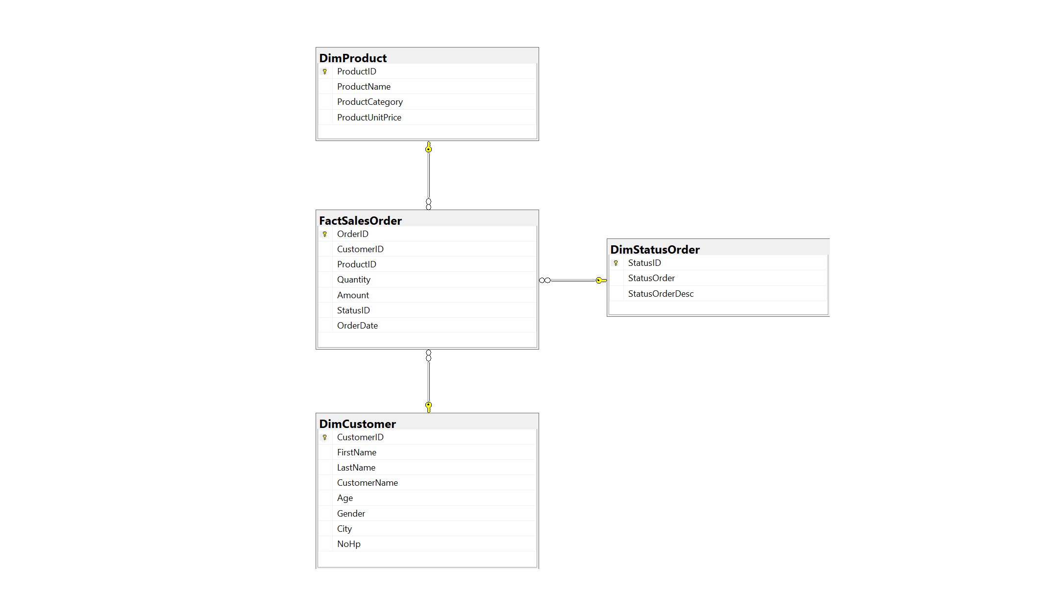
Data Modeling

Slide 20
Developing the Stored Procedures

Slide 21
Query for Creating a Stored Procedure
CREATE PROCEDURE summary_order_status
@StatusID INT
AS
BEGIN
-- Definisikan CTE untuk melakukan JOIN antara tabel
WITH CTE AS (
SELECT fso.OrderID, dc.CustomerName, dp.ProductName, fso.Quantity, dso.StatusOrder
FROM FactSalesOrder AS fso
JOIN DimCustomer AS dc ON fso.CustomerID = dc.CustomerID
JOIN DimProduct AS dp ON fso.ProductID = dp.ProductID
JOIN DimStatusOrder AS dso ON fso.StatusID = dso.StatusID
WHERE dso.StatusID = @StatusID
)
-- Menggunakan SELECT untuk memilih kolom dari CTE
SELECT OrderID, CustomerName, ProductName, Quantity, StatusOrder
FROM CTE
END

Slide 22
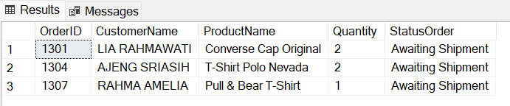
Query & Output of Executing the Stored Procedure
EXEC summary_order_status @StatusID = 2

Slide 23
Dashboard Data Visualization

Slide 24
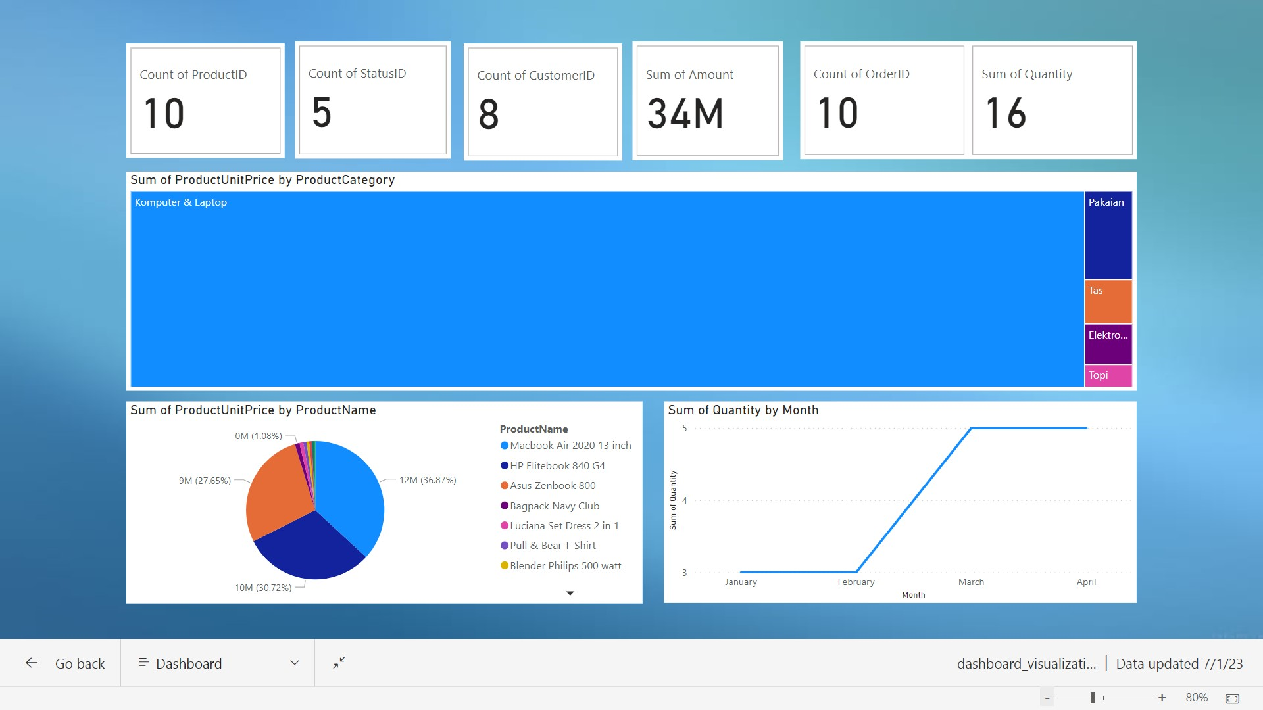
PowerBI Dashboard

Slide 25
Project Resource & Documentation

Slide 26
Github & Youtube Link
https://github.com/adrn-mm/FinalTask_IDX-Partners_DE_Adrian-Maulana-Muhammad
https://www.youtube.com/watch?v=Tbi_46TBJHg

Slide 27
Thank You!

